Slide 1
CAPSTONE PROJECT — FINAL PRESENTATION
Banking77 Customer Intent Classifier
From raw customer messages to a live, public prediction app.
Presenter: Thimar Arda
Date: Week 10 — Final Presentation
Live demo: banking77-intent.streamlit.app

Slide 2
THE PROBLEM
Support teams can't manually triage every message
1
Banks and fintechs receive huge volumes of free-text customer queries.
2
Every message must be routed to the right team — cards, payments, top-ups, accounts — before anyone can help.
3
Goal: automatically classify a message into one of 77 specific banking intents, instantly.

Slide 3
THE DATA
Banking77 dataset
13,083
77
PolyAI
real customer queries
fine-grained intent classes
public banking dataset
Challenge: many classes are semantically close — e.g. card_arrival vs. card_delivery_estimate — making this a genuinely hard 77-way classification problem, not a toy task.

Slide 4
EDA HIGHLIGHTS
What the data showed before modeling
1
Messages are short, informal, real customer phrasing — not clean, templated text.
2
Class sizes vary across the 77 intents, so a naive "guess the biggest class" baseline performs very poorly.
3
Negation matters: "payment not received" and "payment received" must be treated very differently — this shaped preprocessing decisions.

Slide 5
METHODOLOGY
From raw text to a deployed model
1
2
3
4
Preprocess
Vectorize
Model
Explore
Lowercase, strip punctuation, tokenize, remove stopwords (except negations), lemmatize
TF-IDF vectorization of cleaned text
Logistic Regression — fast, small, deploys reliably on free hosting
A fine-tuned DistilBERT transformer was also tested — higher accuracy, but far heavier to deploy

Slide 6
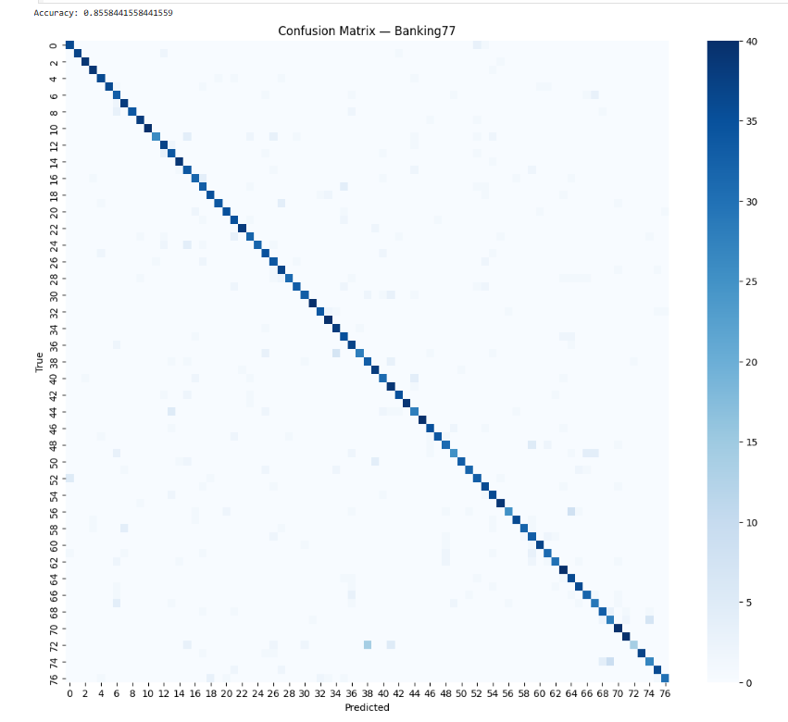
RESULTS
The model correctly identifies intent 86 times out of 100
85.6%
~1.3%
test accuracy
random-guess baseline
for roughly 86 out of every 100 customer messages, the system routes them to the correct team automatically — with no human triage needed.
Strong diagonal = correct predictions dominate across all 77 classes

Slide 7
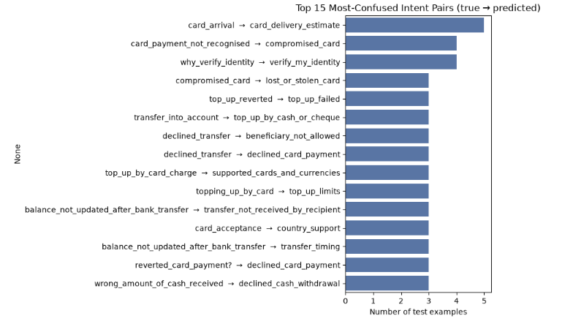
RESULTS — ERROR ANALYSIS
Where the model gets confused
Top 15 most-confused intent pairs — nearly all involve genuinely similar real-world meanings

Slide 8
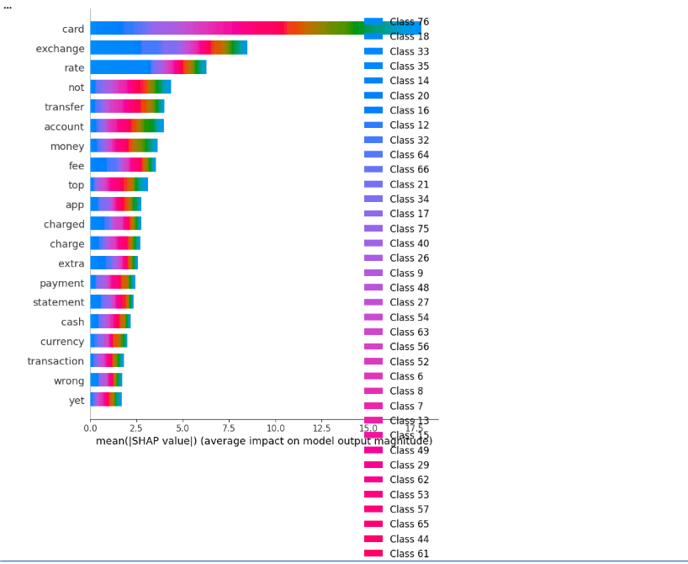
EXPLAINABILITY
What drives a prediction — SHAP analysis
Top words by mean SHAP value — "card", "exchange", "rate", "not" drive the most predictions across classes

Slide 9
LIVE DEMO — PART 1
A real prediction, live
Deployed at: banking77-intent.streamlit.app
Input: "I do not recognize this payment."
→ card_payment_not_recognised (confident)
Input: "I want a new account"
→ terminate_account (confident)

Slide 10
LIVE DEMO — PART 2 (EDGE CASE)
What happens when the model has no signal?
A real limitation found during testing: gibberish or unseen vocabulary produced an all-zero feature vector, and the model still had to output something — silently guessing a default class.
Input: "2222222."
→ unknown (not confident) — guardrail added
Fix: the app now explicitly flags zero-signal inputs instead of returning a fabricated, confident-looking answer.

Slide 11
LIMITATIONS & FUTURE WORK
Honest assessment
A transformer model reached higher accuracy (~92%) but is heavier to deploy on free hosting — a natural next step with better infrastructure.
The confidence guardrail only catches zero-signal inputs, not short ambiguous ones that are still confidently wrong.
Class confusion persists among semantically similar intents.
No feedback loop yet to capture real user corrections for retraining.

Slide 12
CONCLUSION
From notebook to public product
This project covered the full pipeline — EDA, preprocessing, modeling, evaluation, serialization, an API, a UI, and public deployment — while surfacing and fixing real issues along the way, from training/serving skew to deployment-only bugs.
Thank you .

